Slide 1
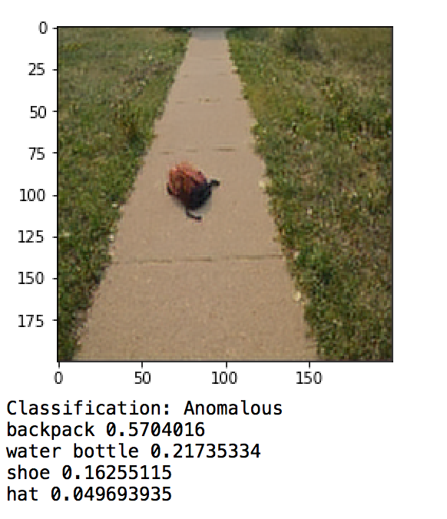
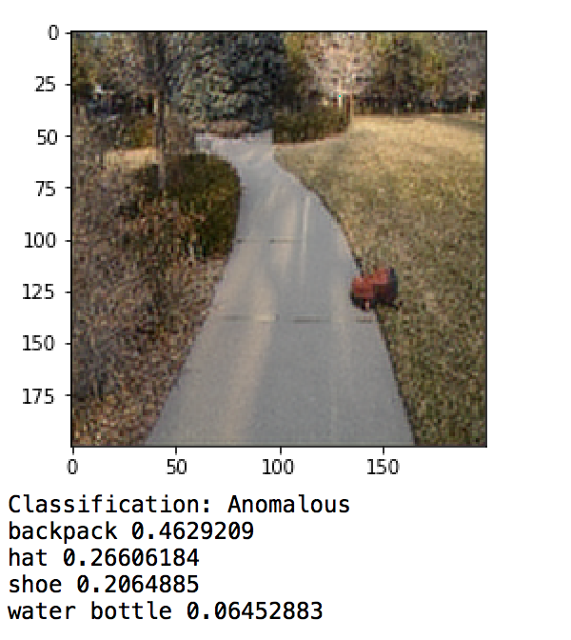
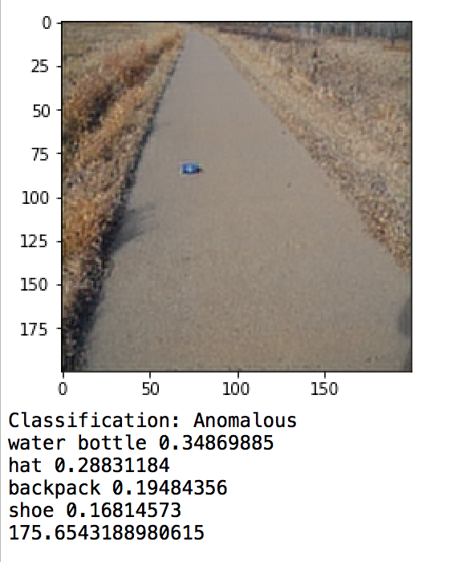
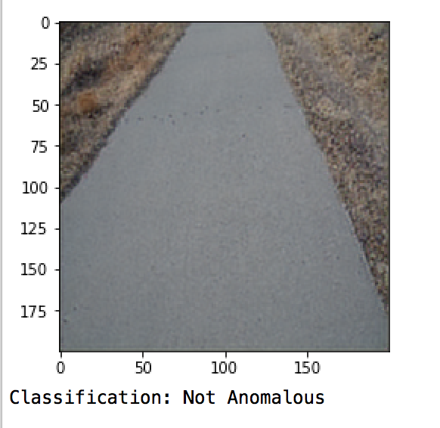
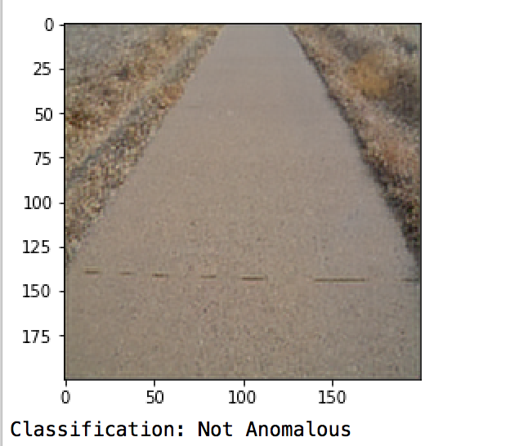
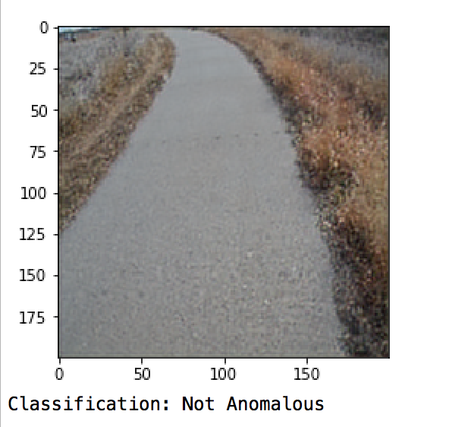
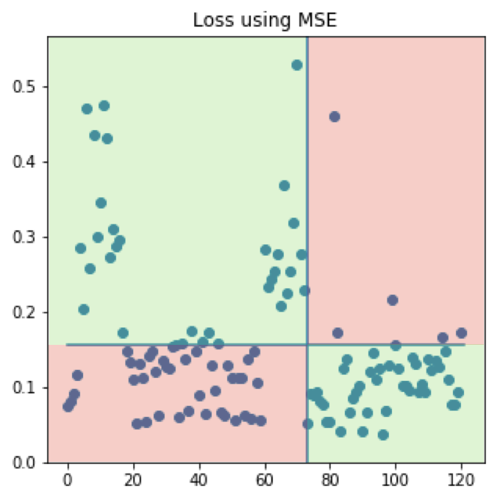
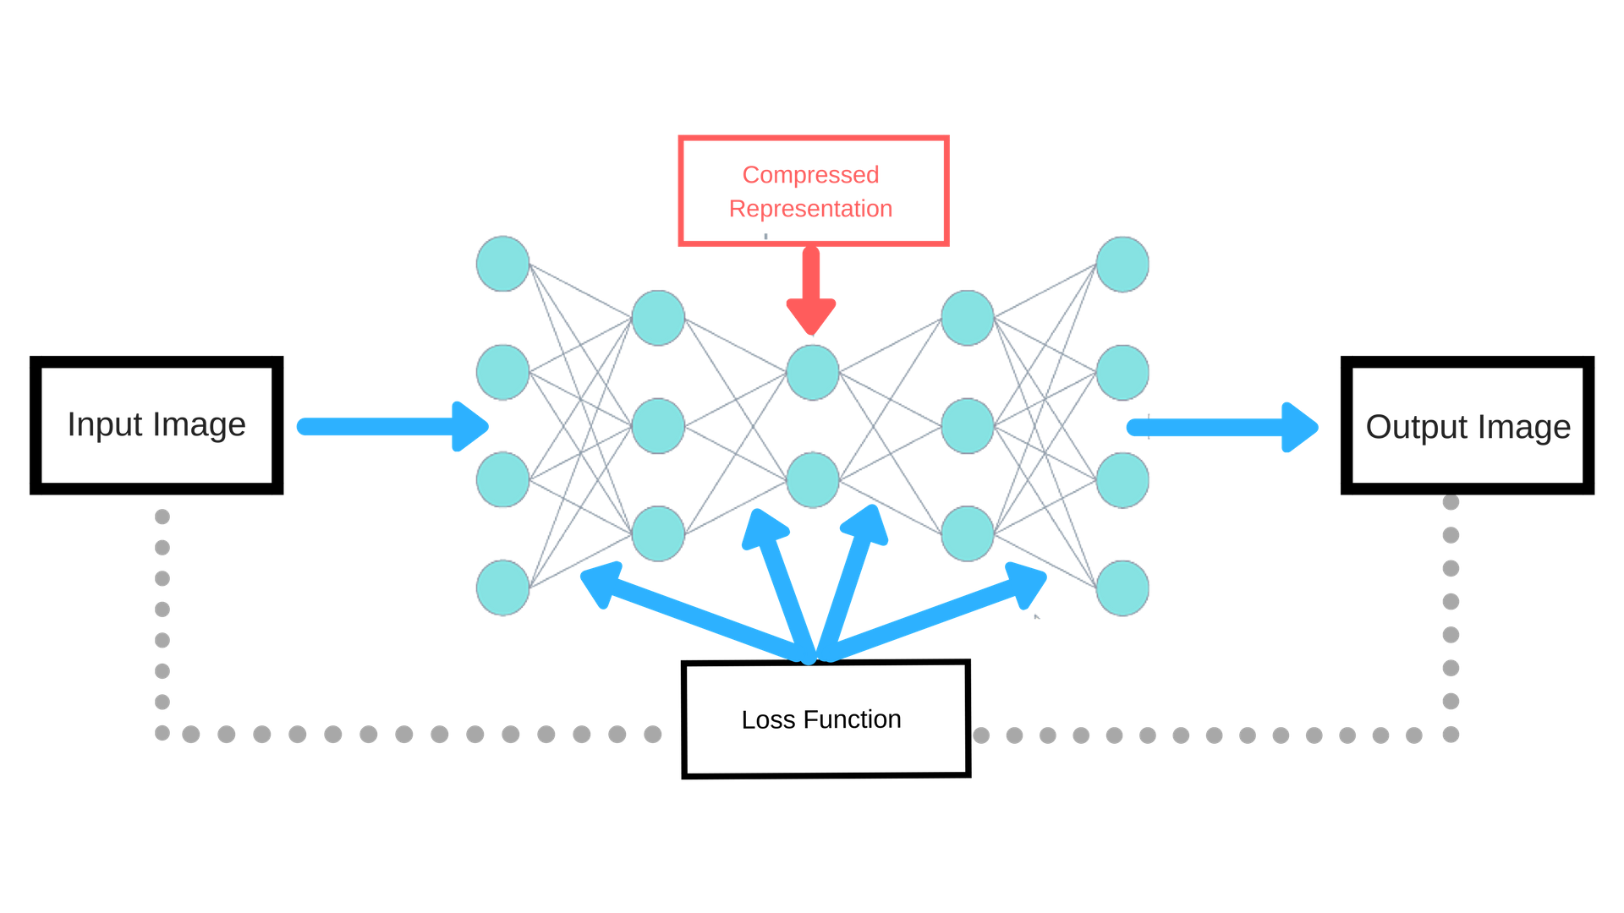
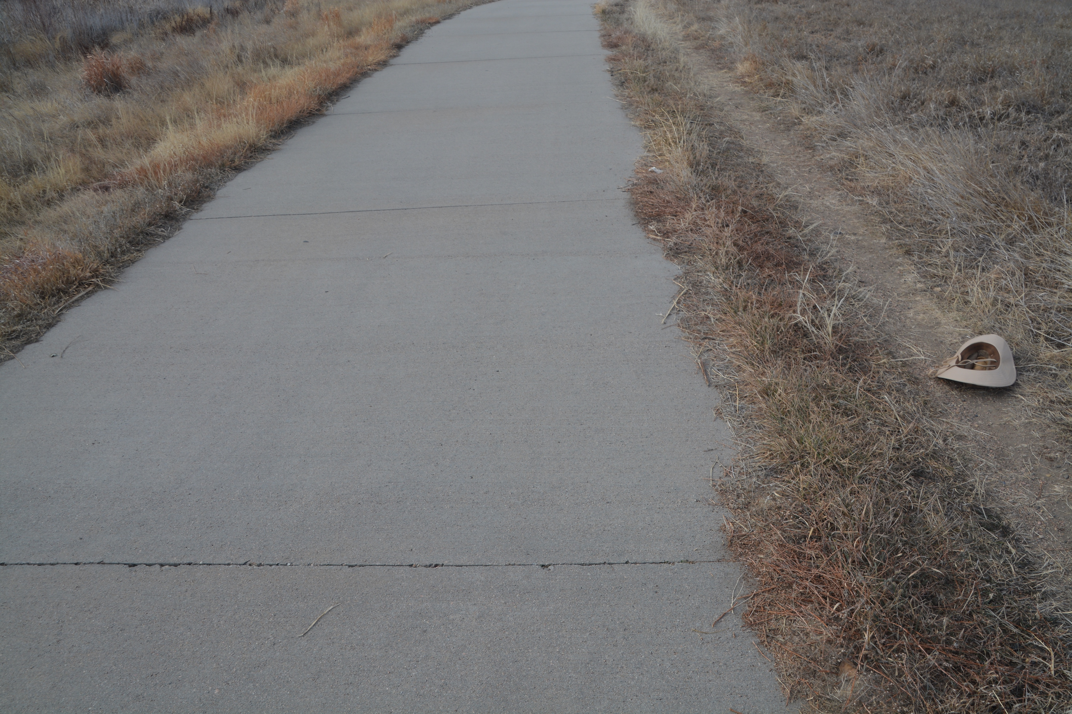
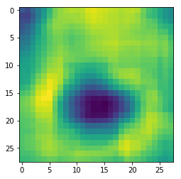
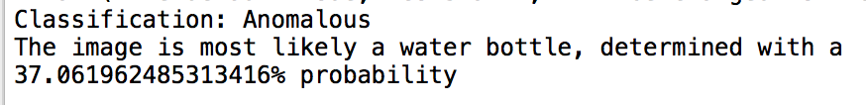
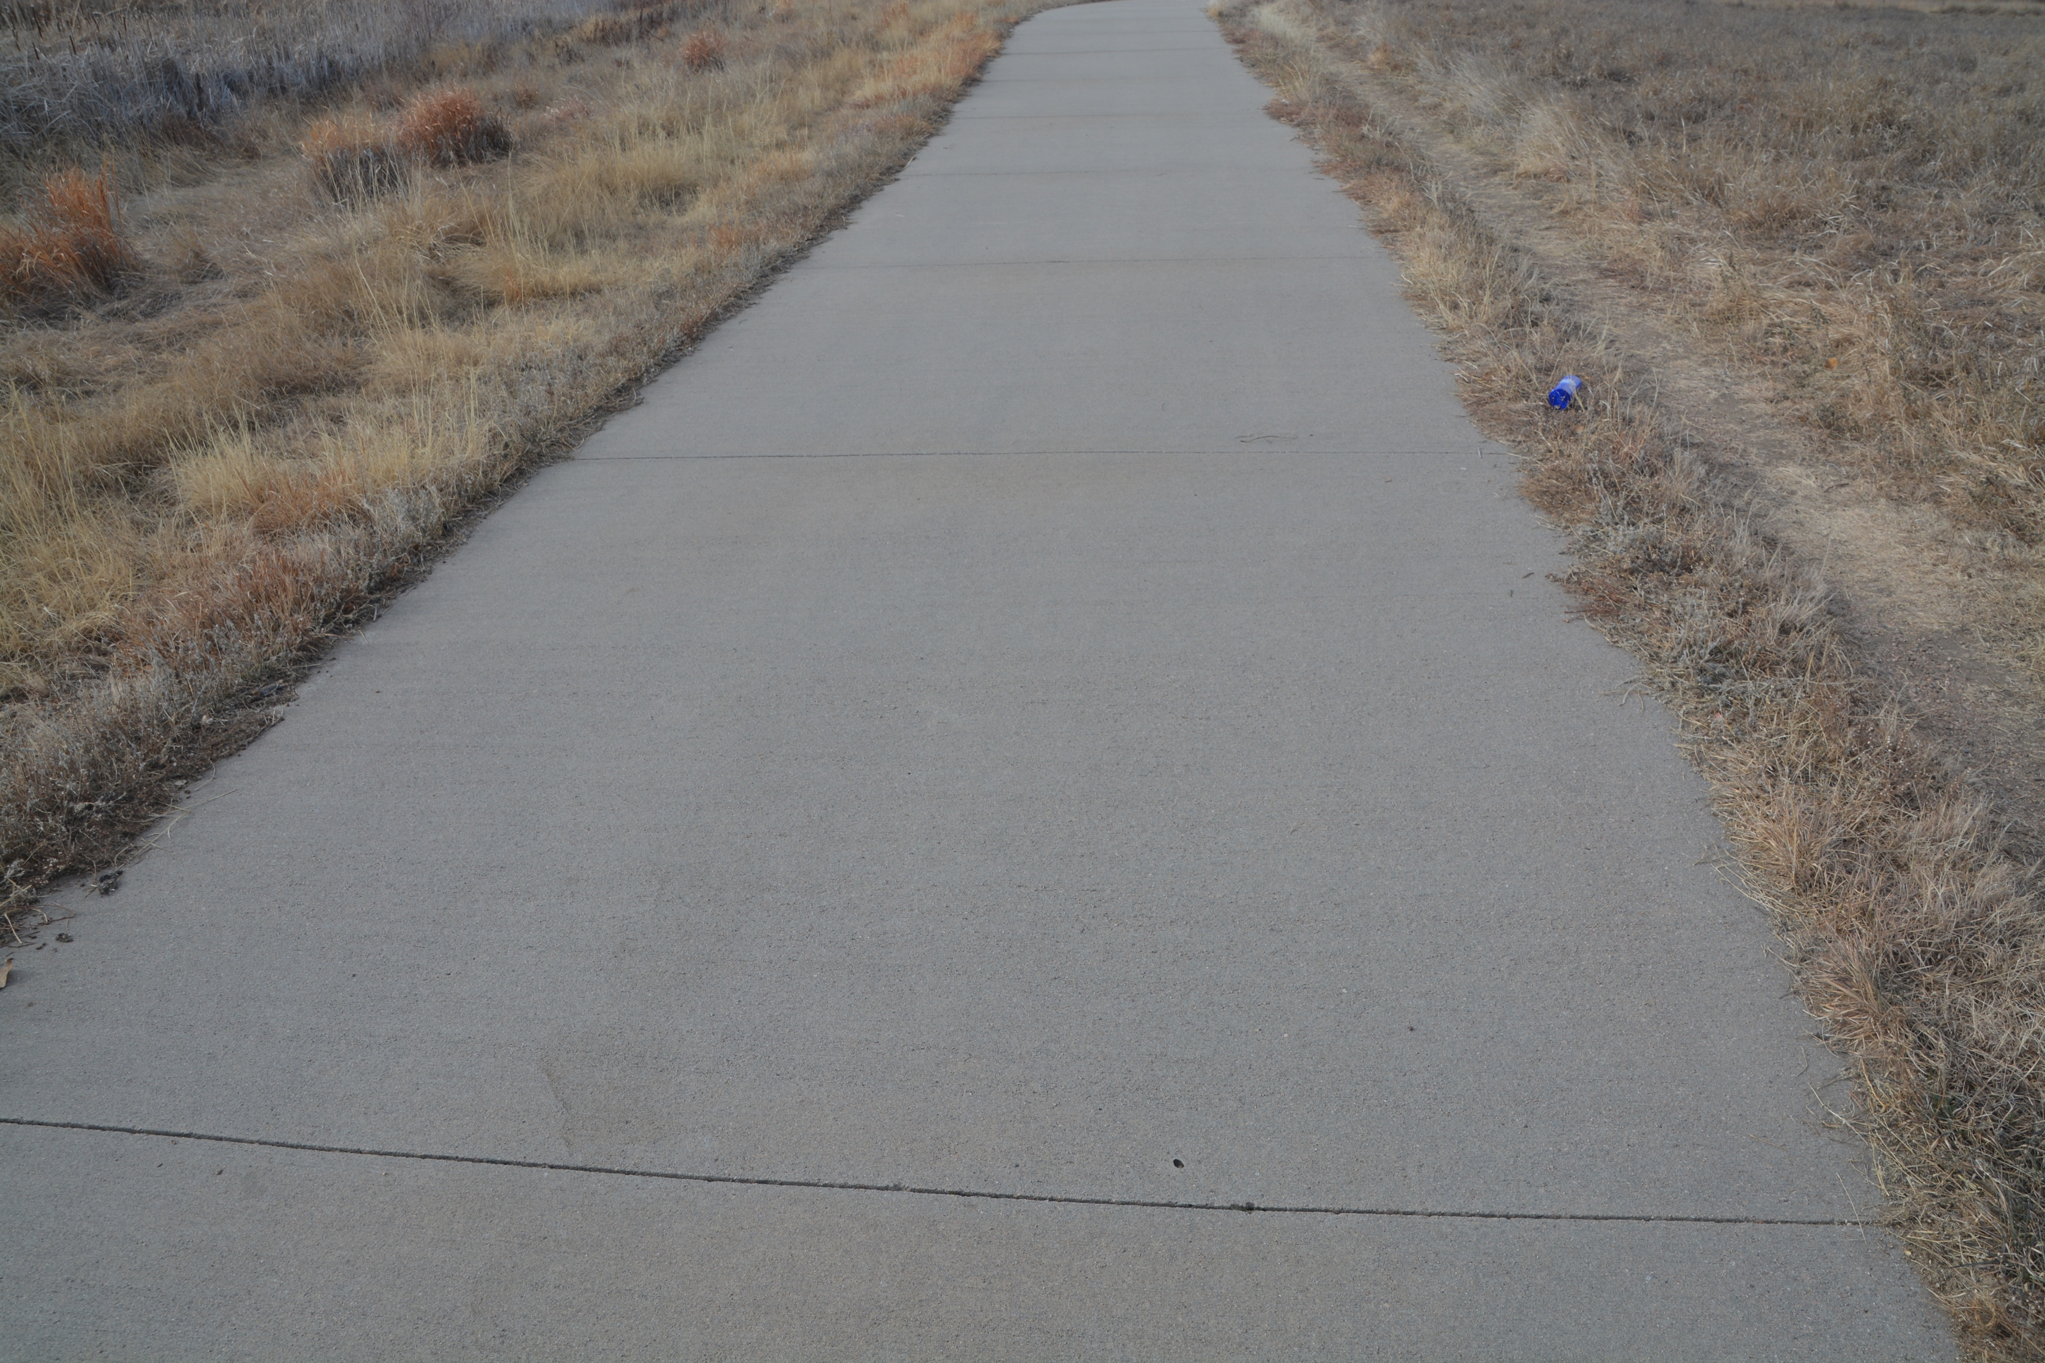
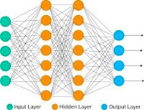
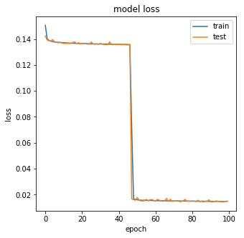
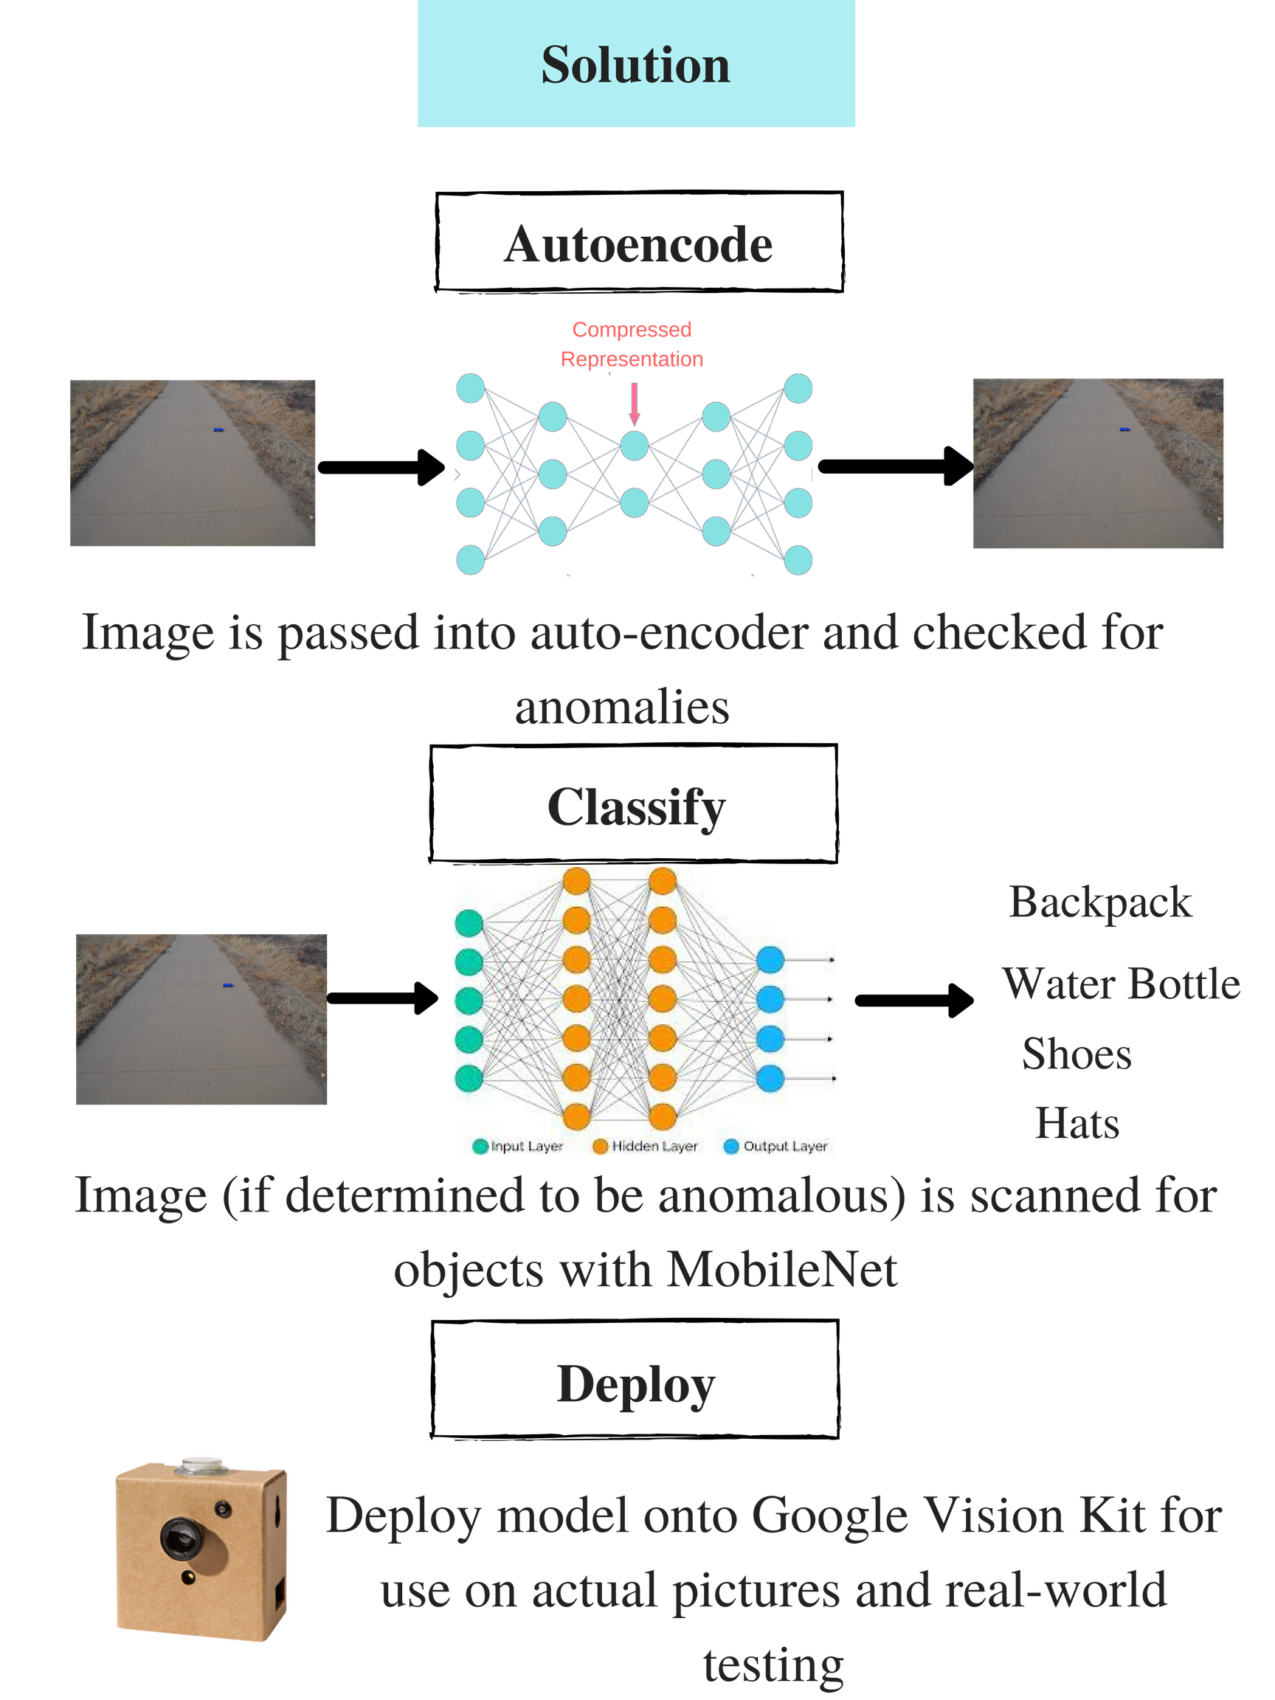
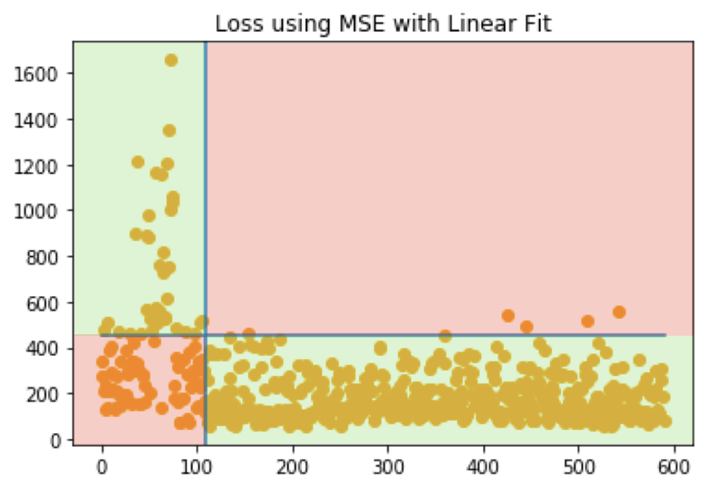
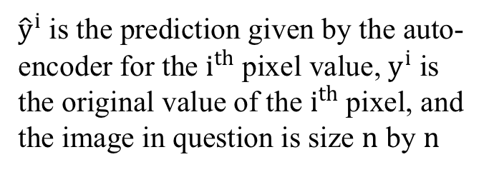
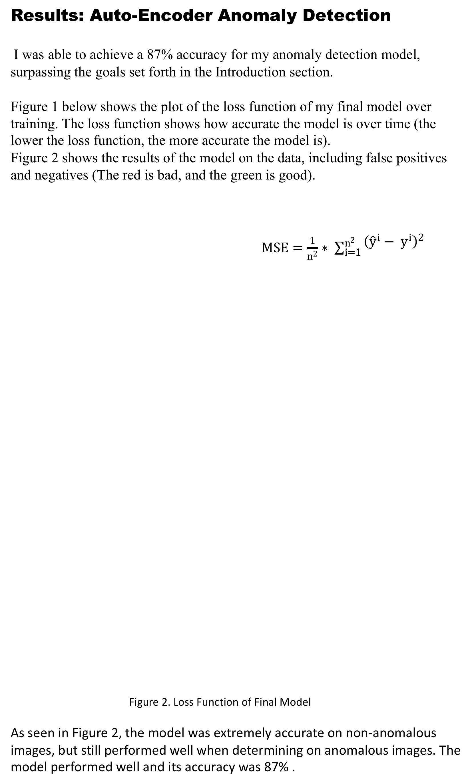
Introduction
Materials & Methods
My project can be split into three stages of work. The first stage is where the auto-encoder model for anomaly detection was constructed. The second stage is where the object classifier was re-trained to classify relevant objects. The final stage is when the models are compiled into binary graphs and deployed to the autonomous device.
Results: Object Classification
After completing the anomaly detection model, I turned to classifying objects in the model, to serve as a sort of double check for anomalies.
I was able to achieve a 93% accuracy for the object classification step of the project, and successfully implemented both models into one functioning super model.
Below are some sample images and their classification by my model
Successful Classifications
Unsuccessful Classification
Discussion
Research Problem
The main inspiration for this project came from the issues search-and-rescue (SAR) teams have in their missions.
It would greatly benefit search and rescue teams in an emergency situation if trails could be searched for anomalies such as hiking boots, backpacks, and water bottles. Additionally, it is hard to have communication between drones involved in a search and a central station.
Is it possible to implement an intelligent program that can run autonomously on a low power device for SAR?
The criteria for the above proposed solution are:
Detection of anomaly from image with an accuracy > 70%
Detection of objects in anomalous image with an accuracy > 80%
Deployment of anomaly and object classification models on vision device
The creation of the anomaly detection model went through several trials before I arrived at the final model.
Trial #1: 22% accuracy. This was due to the model only training on 200 images. Between Trial #1 and #2, roughly 100 more images were added.
Trial #2: 23% Two issues were identified between Trial #2 and Trial #3.
Training dataset was not very specific to the problem
Testing dataset was very small (28 images)
Trial #3: 40% The previous trimming of the datasets proved to be effective, increasing the accuracy to 40%. Between Trial #3 and Trial #4, the loss function was changed from Binary Cross-Entropy to Mean Squared Error because MSE was a better approximation of the differences between images than Binary Cross-Entropy.
Trial#4: 51% This trial proved that MSE was a better choice for a loss function than Binary Cross-Entropy was. Between trials, the number of layers in the auto-encoder was reduced so it wouldn’t learn more representations than it needed to.
Trial #5: 60% Between Trial #5 and Trial #6 over 200 more images were added to the training dataset, and 150 more were added to the testing dataset. In addition, the model was modified to allow it to analyze color images (it had been using gray-scaled images up till this point)
Trial #6: 74% Between Trial #6 and Trial #7, more data was added to the dataset.
Final Model: 87%
Image
Results from earlier trials:
Prediction
The materials involved in Stage 1 of my project were:
A Computer
Python 3.6
A Nikon camera
A Google Vision Kit with Intel Movidius AI Chip
A Raspberry Pi Zero , Camera V2
My project can be divided into 3 separate stages that are described below.
Stage 1: Auto-encoder Anomaly Detection
Collect non-anomalous data from local parks
Create and train anomaly detection model using images
Create error analysis program to determine accuracy of model
Experiment with different loss function, layer numbers, number of nodes within layers, and other parameters to arrive at final model
Repeat Step 4 until goal is surpassed
Stage 2: Object Classification
Collect anomalous data (using objects such as backpacks, hats, shoes, and water-bottles) from local parks
Retrain MobileNet model and change its layers to classify objects in #1
Trim dataset depending on specific images that the model performed badly
Repeats Steps 2 and 3 until goal is surpassed
Background
The main machine learning structure used in this project was the auto-encoder, a neural network whose hidden layers are progressively smaller than the input and output layers, as seen in Figure 1 below.
.
The goal of using an auto-encoder was to both compress images for the object classification step and to learn what was normal for a trail through a training dataset for anomaly detection.
The second structure used was that of the Convolutional Neural Network (CNN). A CNN uses multiple layers of nodes to determine basic feature of an image, starting from simple lines and edges, and building up to faces and objects. A pre-existing CNN was retrained to classify objects for my project into 4 categories (hats, backpacks, shoes, and water bottles).
Figure 2. Convolutional Neural Network Figure 3. Gradient Descent Algorithm
Stage 3: Autonomous Deployment
Construct Google Vision Kit using Raspberry PI Zero & Camera V2
Run sample machine learning models on the Vision Kit to test it
Combine object classification and anomaly detection models into one functioning super model
Import binary model (graphs and scripts) onto the Vision Kit
Test and debug Vision Kit deployment and verify models work with camera
This project reported on the possibilities of creating a novel implementation of transfer learning by combining anomaly detection and object classification into one functioning “super” model. The anomaly detection part of this project was implemented using a deep auto-encoder with two layers, which achieved an 87% final testing accuracy. The auto-encoder model continually suffered from lack of quality data and lack of data in general, but the introduction of color into the model proved to be able to compensate for the amount of data that was collected. The object classification part of my project was hindered by the lack of data from the field, but this was solved by obtaining online images (Google). The re-trained MobileNet model achieved 93.5% accuracy on the testing dataset. Both the results from the project surpass the goals set forth in the Research Problem allowing it to be classified as a success.
Future Pathways
Aside from the obvious improvements of increasing the accuracy of the object classification and anomaly detection models, several others exist. First,
The model could implement an image component separation scheme, like the scheme self-driving cars use to distinguish between cars and passengers.
The model could decrease the time needed for it to conduct transfer learning.
Another improvement could be to condense the two models into one neural network instead of two connected neural networks.
The model could use a Generational Adversarial Network (GAN). GANs are neural networks that have the capabilities to construct an entire dataset from a few images by varying different qualities of the image to create more data. GANs could therefore be used to construct a more extensive dataset on which to train the main model.
Implications
Results
Conclusion
TRIFOLD AREA – THIS GUIDE WILL BE REMOVED BEFORE PRINTING – TRIFOLD AREA – THIS GUIDE WILL BE REMOVED BEFORE PRINTING – TRIFOLD AREA – THIS GUIDE WILL BE REMOVED BEFORE PRINTING – TRIFOLD AREA – THIS GUIDE WILL BE REMOVED BEFORE PRINTING – TRIFOLD
TRIFOLD AREA – THIS GUIDE WILL BE REMOVED BEFORE PRINTING – TRIFOLD AREA – THIS GUIDE WILL BE REMOVED BEFORE PRINTING – TRIFOLD AREA – THIS GUIDE WILL BE REMOVED BEFORE PRINTING – TRIFOLD AREA – THIS GUIDE WILL BE REMOVED BEFORE PRINTING – TRIFOLD
Results: Auto-Encoder Anomaly Detection
I was able to achieve a 87% accuracy for my anomaly detection model, surpassing the goals set forth in the Introduction section.
Figure 1 below shows the plot of the loss function of my final model over training. The loss function shows how accurate the model is over time (the lower the loss function, the more accurate the model is).
Figure 2 shows the results of the model on the data, including false positives and negatives (The red is bad, and the green is good).
$MSE=\frac{1}{n^{2}}∗ \sum_{i=1}^{n^{2}}{\begin{aligned}{\left({\hat{y}}^{i}− y^{i}\right)}^{2} \\ \end{aligned}}$
Figure 2. Loss Function of Final Model
As seen in Figure 2, the model was extremely accurate on non-anomalous images, but still performed well when determining on anomalous images. The model performed well and its accuracy was 87% .
Results: Autonomous Deployment
This stage of my project had more practical results than data. However, I was able to construct the Google Vision Kit and import my combined super model onto the kit for autonomous use.
Google Vision Kit
Below are pictures taken from the construction of the kit.
VisionBonnet Cable VisionBonnet Board Raspberry Pi Zero
Solution Design
${\hat{y}}^{i}$ is the prediction given by the auto-encoder for the $i^{th}$ pixel value, $y^{i}$ is the original value of the $i^{th}$ pixel, and the image in question is size $n$ by $n$
The results of my project have contributed to the growing interest in the uses of auto-encoders in machine learning models (auto-encoders are a relatively new development). My model’s practical applications include the afore-mentioned SAR one, but the beauty of my model is that it can be retrained to fulfill any type of application. I have therefore created a universal anomaly detection / object classification super model.
All pictures taken by the author with two exceptions:: CNN Image Source: https://medium.com/@xenonsta, Auto-encoder Image Source https://www.topbots.com
MSE Function Image : https://www.xycoon.com

